Slide 1
2024 Legislative Review
Presented by: Alexander Goddard, Director of Government Affairs- Colorado Department of State
Presented to: The Bipartisan Election Advisory Commission (BEAC)

Slide 2
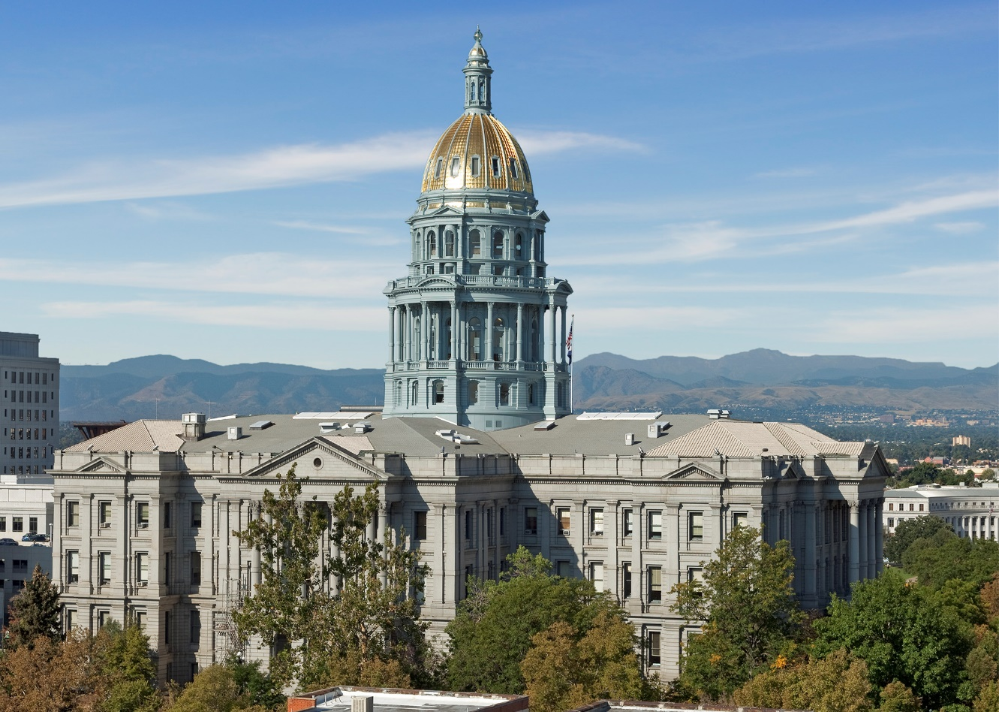
Session Fast Facts:
January of 2024 convened the Second Regular Session of the 74th General Assembly of Colorado
Over 775 bills were introduced throughout the 120 days the legislature was in session
10 introduced bills focused on election-reforms
7 bills passed by General Assembly
  6 of those received bi-partisan support
Photo of the Colorado Capitol Building.

Slide 3
Modifications to Laws Regarding Elections (SB24-210)
Sponsored by: Senators Fenberg and B. Pelton, Representative Sirota
Key provisions:
  15 Year-old preregistration
    Will cover individuals getting their learners permit in the state’s automatic voter registration program
  Voter Service and Polling Center waiver pilot program for one county
    Logan County selected as the pilot for November 2024 election
  Additional time for county clerks to fill open record requests during an election
  Aligns post-election deadlines regarding election contests with Federal requirements
  Explicitly allows voters present in the state for less than 22 days to cast a ballot for President and Vice President only
    Required by Federal law

Slide 4
Voting for Confined Eligible Electors (SB24-72)
Sponsored by: Senator Gonzales, Representatives Brown and Rutinel
  First in the nation bill
  Requires at least one, six-hour day of in-person voting at a jail facility for eligible voters in general elections beginning this November.
    Eligible confined electors include pre-trial detainees, those serving misdemeanor offenses
  Sheriffs designate one main point of contact to work with the clerk to meet bill requirements
  Enhances requirements regarding mail ballot pickup and drop off
    At least one pickup on election day no earlier than 3PM
  SOS and clerks working to train and get materials ready for this November

Slide 5
Candidate Election Deepfake Disclosures (HB24-1147)
Sponsored by: Representatives Joseph and Titone, Senators Buckner and Hansen
Regulates the use of 'deepfakes' of candidates produced using generative artificial intelligence in communications.
Prohibits AI-generated communications of a candidate without a clear and conspicuous disclosure.
Proper disclosure requires the statement: "This (image/audio/video/multimedia) has been edited and depicts speech or conduct that falsely appears to be authentic or truthful"
Applies to any covered communication disseminated within 60 days of a Primary election or 90 days of a General election.
Enforcement:
  A person may file a complaint with the Secretary of State’s office for review, and violators may be fined civil penalties.
  Candidates who are the subject of undisclosed AI-generated communications may file a civil action with the courts for injunctive and other relief/damages.

Slide 6
False Slates of Electors (HB24-1150)
Sponsored by: Representatives Garcia and Parenti, Senator Hinrichsen
Criminalizes efforts to use 'false electors' schemes to overturn a state’s electoral results.
Prohibits:
  Conspiring or agreeing to participate in a plan to create an alternative slate of presidential electors;
  An individual from knowingly and falsely swearing the oath for presidential electors, or persuading someone else to;
  Creating, signing, or filing a list of false presidential electors with specified state or federal entities.
A person convicted of serving as a false elector would be prohibited from:
  Holding any office of trust or profit in the state of Colorado.
  Serving as an Election Judge, Designated Election Official, or Watcher in the state of Colorado.

Slide 7
SOS Review of Municipal Campaign Finance Complaints (HB24-1283)
Sponsored by: Representatives Willford and Marvin, Senator Mullica
Allows the clerk of a municipality to refer a municipal campaign finance complaint to the secretary of state (SOS) under certain conditions.
A municipal clerk may refer a complaint to the SOS if:
  The complaint would create a conflict of interest for the clerk or the clerk's staff and;
  The municipality has adopted an ordinance that authorizes the municipality to refer a campaign finance complaint to the secretary.
Additionally, a statutory municipality that does not have an established campaign finance complaint & hearing process may refer a complaint to the SOS if the municipality has adopted an ordinance authorizing this process.
A municipality may not refer a complaint unless it has provided the SOS with the adopted ordinance at least 180 days before the next election.

Slide 8
Other Changes
SB24-131 – PROHIBITING CARRYING FIREARMS IN SENSITIVE SPACES: Adds concealed carry to the existing prohibitions within 100 feet of a Vote Center, drop box, or Central County Facility
HB24-1067 – BALLOT ACCESS FOR CANDIDATES WITH DISABILITIES: Adds a requirement that any person must be able to participate in a precinct caucus or a party assembly with the use of video conferencing. Candidates petitioning onto the ballot can now begin circulating petitions on the first business day of January instead of the third Tuesday in January.
SCR24-002 - MODIFY CONSTITUTIONAL ELECTION DEADLINES: Constitutional referred measure that will appear on the 2024 General Election Ballot. Would allow our office to certify content 1 week earlier for general elections by requiring petition proponents to turn in petitions 1 week earlier.

Slide 9
Comparison of County Election Costs 2024
2020 Pres Primary Reimbursements | 2024 Pres Primary Reimbursements | 2020 to 2024 Increase $ | 2020 to 2024 Increase %
$7,309,845 | $10,494,037 | $3,184,193 | 43.56%

