Slide 1
Results of 2023 RLA
Colorado’s Gold Standard Risk Limiting Audit
Christopher P. Beall
Deputy Secretary of State

Slide 2
A Brief History of the RLA
2009 – Colorado becomes the first state to enact legislation calling for the use of risk-limiting audits. (C.R.S. § 1-7-515.)
2017 – Secretary Williams adopts first set of rules for the RLA.
2017 – First statewide RLA conducted in counties that use ballot tabulation machines.
2023 – The eleventh RLA is conducted following the 2023 Coordinated Election.

Slide 3
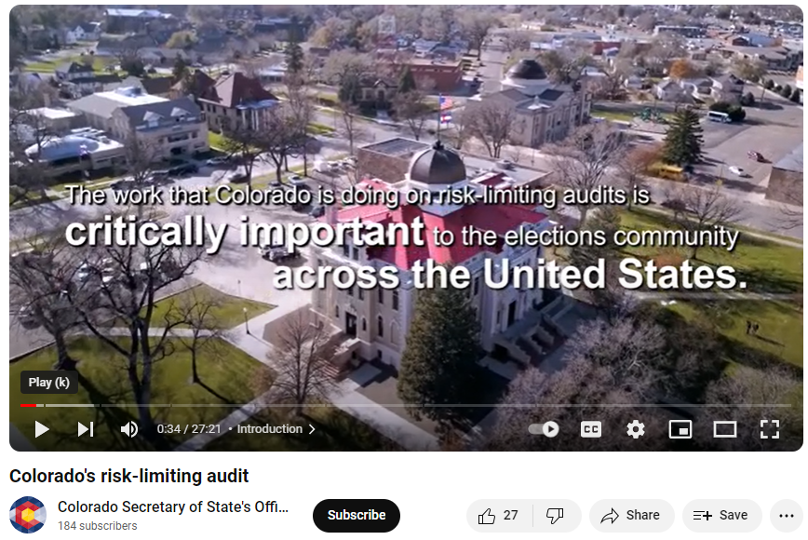
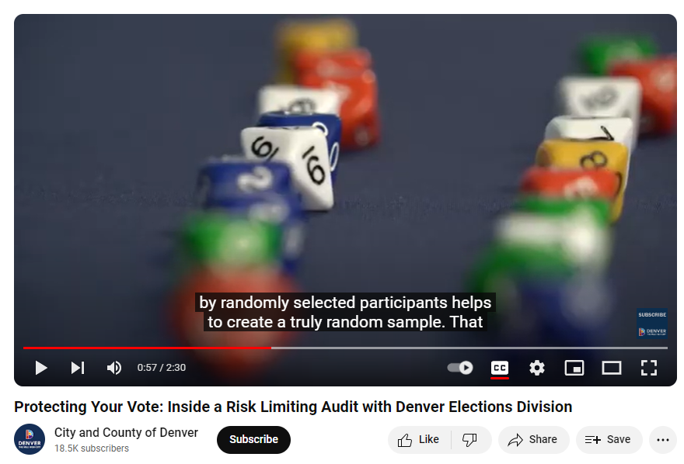

Slide 4
The 2023 Risk Limiting Audit

Slide 5
Oct. 6, 2023 (32 days before election day) – Secretary Griswold announced the “risk limit” for the 2023 RLA: 3%.
Oct. 23, 2023 (15 days before election day) – County Clerks (with nominations from major-party chairs) appointed their audit boards for the 2023 RLA.
Nov. 7, 2023 – Election Day
Nov. 9, 2023 (Thursday after election day – Friday was Veterans Day) – Secretary selected target races.
Nov. 17, 2023 (10 days after election day) –
  Counties uploaded cast vote records and ballot manifests.
  Random seed was drawn.
  Division notified counties of ballots selected to be audited.
Nov. 18, 2023 – 24 counties completed the first round of the RLA.
Nov. 20, 2023 – All 63 participating counties completed the state-race audit, with all but one county also finishing their local-race audit.
Nov. 21, 2023 – RLA completed, all target-race outcomes confirmed.

Slide 6
State Race Target Selection
1,441,848 | Ballots Cast |  |  |  | # of ballot cards: |  | 1 |  | 4
3% | Risk Limit
County | Contest | Vote For | # of Choices | Lowest Winner | Highest Loser | Contest Margin | Diluted Margin | Risk Limit | # of CVRs to audit | Contest Ballots Cast | # of Counties
Colorado | Proposition HH (STATUTORY) | 1 | 2 | 856,182 | 566,663 | 289,519 | 20.08% | 3% | 36 | 1,441,848 | 64
Colorado | Proposition II (STATUTORY) | 1 | 2 | 946,617 | 471,905 | 474,712 | 32.92% | 3% | 22 | 1,441,848 | 64

Slide 7
El Paso County – Target Race Selection
154,291 | Ballots Cast |  |  |  | # of ballot cards: |  | 1 |  | 95
3% | Risk Limit
County | Contest | Vote For | # of Choices | Lowest Winner | Highest Loser | Contest Margin | Diluted Margin | Risk Limit | # of CVRs to audit | Contest Ballots Cast | # of Counties
El Paso | City of Fountain Council Member - At Large | 2 | 3 | 1,181 | 1,003 | 178 | 0.12% | 3% | 6,316 | 3,875 | 1
El Paso | City of Manitou Springs Mayor | 1 | 3 | 895 | 526 | 369 | 0.24% | 3% | 3,047 | 1,553 | 1
El Paso | City of Manitou Springs City Council | 3 | 10 | 538 | 441 | 97 | 0.06% | 3% | 11,591 | 1,553 | 1
El Paso | Academy School District 20 Board of Directors | 2 | 4 | 16,180 | 13,923 | 2,257 | 1.46% | 3% | 498 | 36,087 | 1
El Paso | Cheyenne Mountain School District 12 Board of Directors | 3 | 5 | 3,125 | 2,715 | 410 | 0.27% | 3% | 2,742 | 10,000 | 1
El Paso | Colorado Springs School District 11 Board of Directors | 4 | 10 | 20,510 | 18,965 | 1,545 | 1.00% | 3% | 728 | 51,961 | 1
El Paso | Fountain-Fort Carson School District 8 Board of Directors | 3 | 4 | 899 | 889 | 10 | 0.01% | 3% | 112,432 | 3,808 | 1
El Paso | Hanover School District 28 Board of Directors | 3 | 5 | 122 | 91 | 31 | 0.02% | 3% | 36,268 | 355 | 1
El Paso | Harrison School District No. 2 Board of Directors | 2 | 3 | 3,154 | 2,370 | 784 | 0.51% | 3% | 1,434 | 8,522 | 1
El Paso | Lewis-Palmer School District 38 Board of Directors - District 2 | 1 | 2 | 5,305 | 4,869 | 436 | 0.28% | 3% | 2,579 | 14,213 | 1
El Paso | Manitou Springs School District 14 Board of Directors | 3 | 4 | 1,190 | 960 | 230 | 0.15% | 3% | 4,888 | 3,303 | 1
El Paso | Widefield School District 3 Board of Directors | 2 | 5 | 2,597 | 2,592 | 5 | 0.00% | 3% | 224,864 | 9,216 | 1
El Paso | El Paso County School District 49 Board of Directors - District 2 | 1 | 2 | 2,640 | 1,941 | 699 | 0.45% | 3% | 1,608 | 6,234 | 1
El Paso | El Paso County School District 49 Board of Directors - District 3 | 1 | 2 | 1,794 | 1,351 | 443 | 0.29% | 3% | 2,538 | 4,445 | 1
El Paso | City of Colorado Springs Ballot Issue 2A | 1 | 2 | 53,811 | 49,227 | 4,584 | 2.97% | 3% | 245 | 109,279 | 1
El Paso | City of Fountain Ballot Issue 2B | 1 | 2 | 1,466 | 1,231 | 235 | 0.15% | 3% | 4,784 | 3,875 | 1
El Paso | Academy School District 20 Ballot Issue 4A | 1 | 2 | 19,597 | 14,685 | 4,912 | 3.18% | 3% | 229 | 36,087 | 1
El Paso | Ellicott School District 22 Ballot Issue 4B | 1 | 2 | 814 | 208 | 606 | 0.39% | 3% | 1,855 | 2,883 | 1
El Paso | El Paso County School District 49 Ballot Issue 4C | 1 | 2 | 13,350 | 9,105 | 4,245 | 2.75% | 3% | 265 | 23,615 | 1
El Paso | Donald Wescott Fire Protection District Ballot Issue 6A | 1 | 2 | 1,689 | 1,310 | 379 | 0.25% | 3% | 2,967 | 6,886 | 1
El Paso | Donald Wescott Fire Protection District Northern Subdistrict Ballot Question 6B | 1 | 2 | 1,866 | 963 | 903 | 0.59% | 3% | 1,245 | 5,836 | 1
El Paso | Flying Horse Metropolitan District No. 2 Ballot Issue 6C | 1 | 2 | 864 | 576 | 288 | 0.19% | 3% | 3,904 | 2,434 | 1
El Paso | Flying Horse Metropolitan District No. 2 Ballot Issue 6D | 1 | 2 | 837 | 608 | 229 | 0.15% | 3% | 4,910 | 2,434 | 1
El Paso | Flying Horse Metropolitan District No. 3 Ballot Issue 6E | 1 | 2 | 150 | 44 | 106 | 0.07% | 3% | 10,607 | 2,361 | 1
El Paso | Flying Horse Metropolitan District No. 3 Ballot Issue 6F | 1 | 2 | 142 | 53 | 89 | 0.06% | 3% | 12,633 | 2,361 | 1

Slide 8
Kit Carson County Target Race Selection
2,534 | Ballots Cast |  |  |  | # of ballot cards: |  | 1 |  | 40
3% | Risk Limit
County | Contest | Vote For | # of Choices | Lowest Winner | Highest Loser | Contest Margin | Diluted Margin | Risk Limit | # of CVRs to audit | Contest Ballots Cast | # of Counties
Kit Carson | Bethune School District R-5 Board of Directors | 3 | 4 | 101 | 61 | 40 | 1.58% | 3% | 462 | 194 | 1
Kit Carson | Burlington School District RE-6J Board of Directors | 4 | 11 | 517 | 465 | 52 | 2.05% | 3% | 355 | 1,343 | 1
Kit Carson | Hi-Plains School District R-23 Board of Directors | 3 | 4 | 145 | 90 | 55 | 2.17% | 3% | 336 | 210 | 1
Kit Carson | Stratton School District R-4 Board of Directors | 3 | 7 | 183 | 171 | 12 | 0.47% | 3% | 1,539 | 399 | 1
Kit Carson | Bethune School R-5 Recall of Board of Directors Member - Seth Ebright | 1 | 2 | 99 | 77 | 22 | 0.87% | 3% | 839 | 194 | 1
Kit Carson | Burlington School District RE-6J Ballot Issue 5C | 1 | 2 | 874 | 465 | 409 | 16.14% | 3% | 45 | 1,343 | 1

Slide 9
Hinsdale County Target Race Selection
397 | Ballots Cast |  |  |  | # of ballot cards: |  | 1 |  | 12
3% | Risk Limit
County | Contest | Vote For | # of Choices | Lowest Winner | Highest Loser | Contest Margin | Diluted Margin | Risk Limit | # of CVRs to audit | Contest Ballots Cast | # of Counties
Hinsdale | Archuleta County School District 50 JT Board of Directors - District 2 | 1 | 2 | 10 | 2 | 8 | 2.02% | 3% | 362 | 397 | 2
Hinsdale | Archuleta County School District 50 JT Board of Directors - District 3 | 1 | 2 | 9 | 3 | 6 | 1.51% | 3% | 482 | 397 | 2
Hinsdale | Proposition HH (STATUTORY) | 1 | 2 | 235 | 160 | 75 | 18.89% | 3% | 39 | 397 | 64
Hinsdale | Proposition II (STATUTORY) | 1 | 2 | 244 | 151 | 93 | 23.43% | 3% | 31 | 397 | 64
Hinsdale | Archuleta County School District 50 JT Ballot Issue 5A | 1 | 2 | 9 | 3 | 6 | 1.51% | 3% | 482 | 397 | 2

Slide 10
County | Contest | Vote For | Lowest Winner | Highest Loser | Contest Margin | Diluted Margin | Risk Limit | Estimated # of CVRs to audit | # of CVRs | Remarks
Colorado | Proposition HH (STATUTORY) | 1 | 856,182 | 566,663 | 289,519 | 20.08% | 3% | 36 | 1,441,848 | Audited in all 63 counties
Adams | City of Thornton Mayor | 1 | 13,396 | 11,327 | 2,069 | 2.63% | 3% | 277 | 25,916
Alamosa | Proposition II (STATUTORY) | 1 | 2,241 | 1,447 | 794 | 20.97% | 3% | 35 | 3,787 | Single county audit
Arapahoe | Cherry Creek School District No. 5 Director - District C | 1 | 31,111 | 18,730 | 12,381 | 11.31% | 3% | 64 | 57,781
Archuleta | Archuleta County School District 50 JT Board of Directors - District 3 | 1 | 2,664 | 1,303 | 1,361 | 26.39% | 3% | 28 | 4,975 | Single county audit
Baca | Proposition II (STATUTORY) | 1 | 757 | 506 | 251 | 19.59% | 3% | 37 | 1,281 | Single county audit
Bent | City of Las Animas Mayor | 1 | 279 | 187 | 92 | 7.08% | 3% | 103 | 624
Boulder | City of Boulder Ballot Question 302 | 1 | 16,633 | 10,156 | 6,477 | 6.96% | 3% | 105 | 27,507
Broomfield | Adams 12 Five Star School District Director - District 5 | 1 | 7,148 | 4,692 | 2,456 | 9.30% | 3% | 78 | 14,197 | Single county audit
Chaffee | Northern Chaffee County Library District Ballot Issue 6A | 1 | 2,519 | 1,743 | 776 | 8.19% | 3% | 89 | 4,325
Cheyenne | Proposition II (STATUTORY) | 1 | 457 | 173 | 284 | 45.01% | 3% | 16 | 631 | Single county audit
Clear Creek | Clear Creek School District RE-1 Director - District E | 1 | 1,596 | 1,136 | 460 | 13.94% | 3% | 52 | 3,300
Conejos | Proposition II (STATUTORY) | 1 | 1,122 | 762 | 360 | 17.48% | 3% | 42 | 2,060 | Single county audit
Costilla | Costilla County Ballot Issue 1A | 1 | 777 | 370 | 407 | 34.09% | 3% | 21 | 1,194
Crowley | Crowley County School District RE1-J Board of Directors - 2 Year Term | 1 | 472 | 351 | 121 | 10.68% | 3% | 68 | 1,051 | Single county audit
Custer | Custer County School District C-1 Board of Directors - At Large | 3 | 1,031 | 782 | 249 | 9.58% | 3% | 76 | 2,461
Delta | Delta County School District 50J Board of Education Director- District 4 | 1 | 5,387 | 4,220 | 1,167 | 10.42% | 3% | 70 | 11,199 | Single county audit
Denver | Denver Public Schools Director - District 1 | 1 | 14,285 | 11,448 | 2,837 | 2.41% | 3% | 303 | 29,130
Dolores | Rico Fire Protection District Ballot Issue 6A | 1 | 115 | 42 | 73 | 8.43% | 3% | 86 | 900
Douglas | Town of Parker Ballot Question 2B | 1 | 9,433 | 5,937 | 3,496 | 2.59% | 3% | 281 | 17,081
Eagle | Eagle County Ballot Issue 1A | 1 | 5,929 | 2,270 | 3,659 | 24.18% | 3% | 30 | 8,333
El Paso | City of Colorado Springs Ballot Issue 2A | 1 | 53,811 | 49,227 | 4,584 | 2.97% | 3% | 245 | 109,279
Elbert | Elizabeth School District C-1 Director - 4 Year Term | 2 | 4,334 | 1,731 | 2,603 | 25.03% | 3% | 29 | 7,242
Fremont | Cañon City School District RE-1 Ballot Issue 4A | 1 | 5,846 | 3,679 | 2,167 | 14.51% | 3% | 50 | 9,852
Garfield | Garfield School District RE-2 Board of Directors - District B | 1 | 2,346 | 1,316 | 1,030 | 8.37% | 3% | 87 | 4,564
Gilpin | Gilpin County Ballot Issue 1A | 1 | 1,618 | 915 | 703 | 27.48% | 3% | 27 | 2,558
Grand | Grand County Ballot Issue 1A | 1 | 3,943 | 1,491 | 2,452 | 44.07% | 3% | 17 | 5,564
Gunnison | City of Gunnison Ballot Issue 2B | 1 | 1,336 | 475 | 861 | 12.57% | 3% | 58 | 1,897
Hinsdale | Proposition II (STATUTORY) | 1 | 244 | 151 | 93 | 23.43% | 3% | 31 | 397 | Single county audit
Huerfano | City of Walsenburg City Clerk | 1 | 590 | 374 | 216 | 7.85% | 3% | 93 | 1,027
Jackson | Jackson County Ballot Issue 1B | 1 | 282 | 171 | 111 | 23.82% | 3% | 31 | 466
Jefferson | City of Lakewood Mayor | 1 | 21,038 | 12,636 | 8,402 | 4.07% | 3% | 179 | 49,523
Kiowa | Proposition II (STATUTORY) | 1 | 372 | 153 | 219 | 41.71% | 3% | 17 | 525 | Single county audit

Slide 11
County | Contest | Vote For | Lowest Winner | Highest Loser | Contest Margin | Diluted Margin | Risk Limit | Estimated # of CVRs to audit | # of CVRs | Remarks
Kit Carson | Burlington School District RE-6J Ballot Issue 5C | 1 | 874 | 465 | 409 | 16.14% | 3% | 45 | 1,343
La Plata | Upper Pine River Fire Protection District Ballot Issue 7A | 1 | 2,525 | 1,037 | 1,488 | 8.16% | 3% | 89 | 3,664 | Single county audit
Lake | Lake County School District R-1 Ballot Issue 4A | 1 | 1,235 | 788 | 447 | 21.25% | 3% | 34 | 2,104
Larimer | Poudre School District R-1 Director - District F | 1 | 24,313 | 21,276 | 3,037 | 3.02% | 3% | 241 | 55,476
Las Animas | Proposition II (STATUTORY) | 1 | 2,706 | 2,162 | 544 | 10.81% | 3% | 67 | 5,033 | Single county audit
Lincoln | Proposition II (STATUTORY) | 1 | 962 | 532 | 430 | 28.63% | 3% | 25 | 1,502 | Single county audit
Logan | City of Sterling Mayor | 1 | 1,508 | 1,242 | 266 | 4.18% | 3% | 175 | 3,062
Mesa | City of Grand Junction Ballot Question 2A | 1 | 11,275 | 8,507 | 2,768 | 5.46% | 3% | 134 | 20,940
Mineral | Creede School District Board Director | 2 | 341 | 251 | 90 | 15.10% | 3% | 48 | 596
Moffat | Moffat County Ballot Question 1A | 1 | 2,153 | 1,446 | 707 | 19.26% | 3% | 38 | 3,671
Montezuma | Montezuma-Cortez School District RE-1 Director - District C | 1 | 2,229 | 1,667 | 562 | 6.74% | 3% | 108 | 4,939
Montrose | Proposition II (STATUTORY) | 1 | 7,798 | 6,836 | 962 | 6.48% | 3% | 112 | 14,849 | Single county audit
Morgan | Proposition II (STATUTORY) | 1 | 4,018 | 3,109 | 909 | 12.60% | 3% | 58 | 7,214 | Single county audit
Otero | City of La Junta Referred Ballot Issue 2A | 1 | 1,160 | 731 | 429 | 8.56% | 3% | 85 | 1,954
Ouray | Town of Ridgway Ballot Issue 2A | 1 | 340 | 174 | 166 | 6.29% | 3% | 116 | 534
Park | Park County Ballot Issue 1A | 1 | 3,842 | 2,805 | 1,037 | 14.92% | 3% | 49 | 6,689
Phillips | Holyoke School District RE-1J Board of Directors - 2 Year Term | 2 | 597 | 412 | 185 | 10.54% | 3% | 69 | 1,095 | Single county audit
Pitkin | Town of Snowmass Village Ballot Question 2A | 1 | 588 | 241 | 347 | 6.66% | 3% | 109 | 876
Prowers | City of Lamar Mayor | 1 | 773 | 624 | 149 | 4.45% | 3% | 164 | 2,039
Pueblo | City of Pueblo Ballot Question 2A | 1 | 14,728 | 12,421 | 2,307 | 5.08% | 3% | 143 | 27,647
Rio Blanco | Proposition II (STATUTORY) | 1 | 1,136 | 714 | 422 | 22.63% | 3% | 32 | 1,865 | Single county audit
Rio Grande | Proposition II (STATUTORY) | 1 | 1,837 | 1,542 | 295 | 8.64% | 3% | 84 | 3,415 | Single county audit
Routt | City of Steamboat Springs Ballot Question 2I | 1 | 2,777 | 2,290 | 487 | 5.26% | 3% | 139 | 5,123
Saguache | Proposition II (STATUTORY) | 1 | 1,094 | 673 | 421 | 23.08% | 3% | 32 | 1,824 | Single county audit
San Miguel | Telluride School District R-1 Board of Directors | 3 | 948 | 548 | 400 | 12.89% | 3% | 57 | 2,561
Sedgwick | Proposition II (STATUTORY) | 1 | 468 | 356 | 112 | 13.51% | 3% | 54 | 829 | Single county audit
Summit | Summit School District RE-1 Board of Directors - At Large | 4 | 4,790 | 3,290 | 1,500 | 15.32% | 3% | 48 | 9,745
Teller | Woodland Park School District RE-2 Board of Directors - District C | 1 | 4,683 | 4,444 | 239 | 2.11% | 3% | 346 | 9,543
Washington | Proposition II (STATUTORY) | 1 | 1,260 | 549 | 711 | 38.87% | 3% | 19 | 1,829 | Single county audit
Weld | City of Greeley Councilmember - At Large | 1 | 8,378 | 4,982 | 3,396 | 5.12% | 3% | 142 | 17,589
Yuma | Wray School District RD-2 Board of Education Directors - 4 Year Term | 3 | 884 | 674 | 210 | 6.91% | 3% | 105 | 1,295

Slide 12
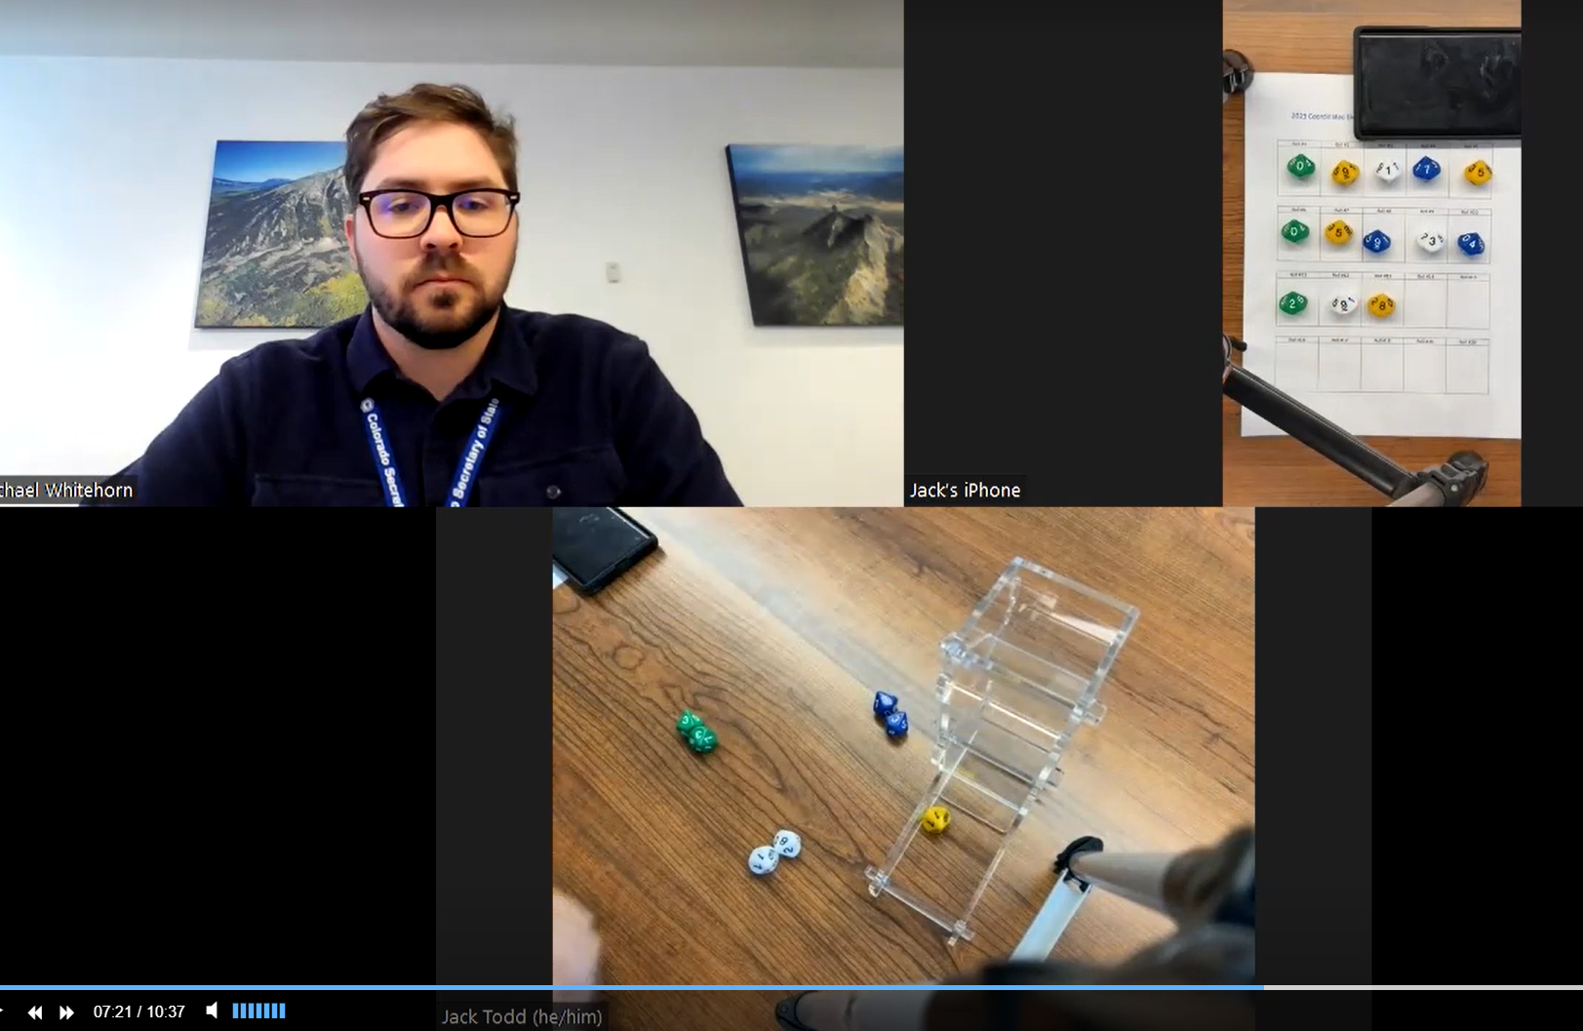

Slide 13
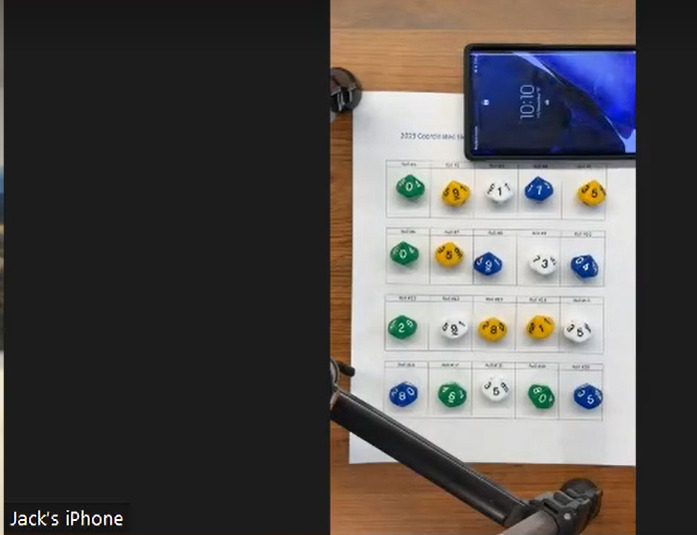

Slide 14
Total Ballots Pulled:
36 ballots across the state for state-race audit
5,694 ballots across each of the 63 counties for local-race audit

Slide 15
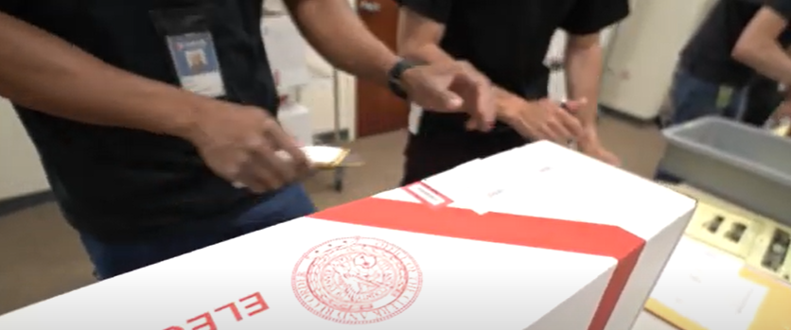
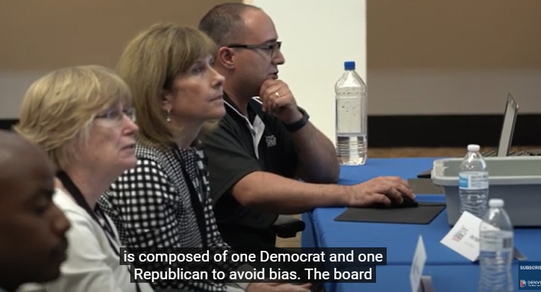
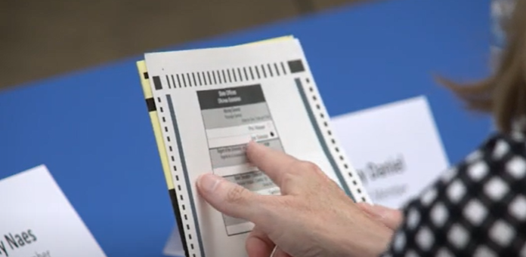

Slide 16
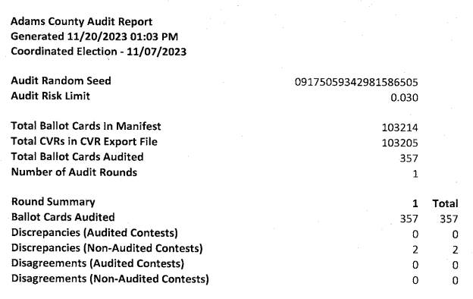
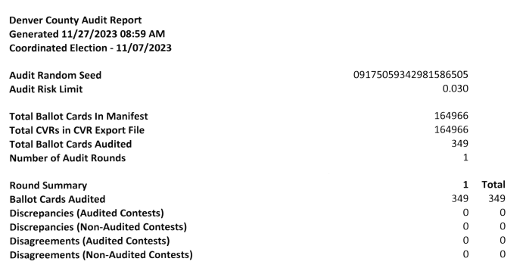
RLA Results

Slide 17
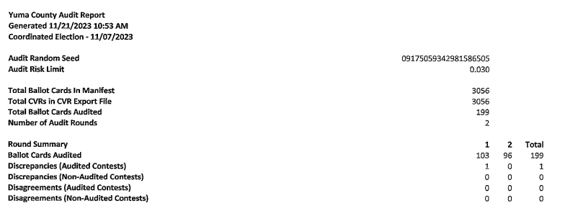
RLA Results

Slide 18
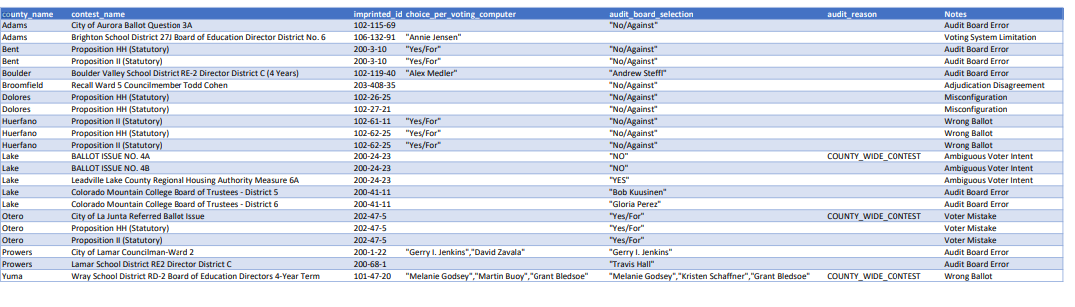
2023 RLA Results
22 discrepancies identified
0 outcomes overturned

Slide 19
Questions?

