Slide 1
Colorado Department of State
Judd Choate, State Election Director
BEAC 2023 Coordinated Election Data
December 15, 2023
303-869-4927
judd.choate@coloradosos.gov

Slide 2
Voter Registration
Colorado Department of State

Slide 3
Who is Eligible to Register to Vote in Colorado (and most of the U.S.)?
Legal Requirements:
Must be a U.S. Citizen
Must be 16 years of age (18 to vote)
Must be a Colorado resident
Can’t be a currently incarcerated Felon
What is residency? Legal term for where a person calls ”home.”

Slide 4
Colorado’s “All-In” Approach on Registration
Online Voter Registration DL 2010
Eligible But Unregistered Mailing 2012
Same Day Registration 2013
Pre-Registration Ages 16 & 17 2013
Naturalization Ceremonies 2014
Eligible But Unregistered Mailing 2014
AVR Opt-In 2016
Eligible But Unregistered Mailing 2016
Eliza Pickrell Routt Award 2016
Census Comparison to Voter Registration 2017
Eligible But Unregistered Mailing 2018
AVR Opt-Out 2019
Only Currently Incarcerated Restricted 2019
AVR Full Backend 2020
Online Voter Registration SSN 2022
AVR for Ute Tribes 2023

Slide 5
Automatic Voter Registration
Colorado Department of State

Slide 6
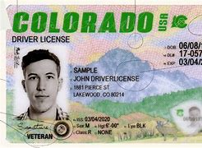
Automatic Voter Registration
Three Possibilities:
Voter Registration for an Eligible Citizen
The person is ineligible
  Not a Citizen
  Not 16 years of age yet
Currently Registered Voter
(If Data Moves Forward…)
Two Outcomes:
The elector’s county clerk verifies that the record is complete. If not, the registration is made incomplete and the voter is sent a mailing requesting the missing information.
If the elector’s record is complete, the county clerk approves the registration and sends a notice to the elector that they are registered to vote.
  The elector can return the notice to either decline to be registered or to affiliate with a party.
  If the elector does not decline to be registered within 20 days after the notice is mailed and the form is not returned as undeliverable, the elector is then registered to vote.

Slide 7
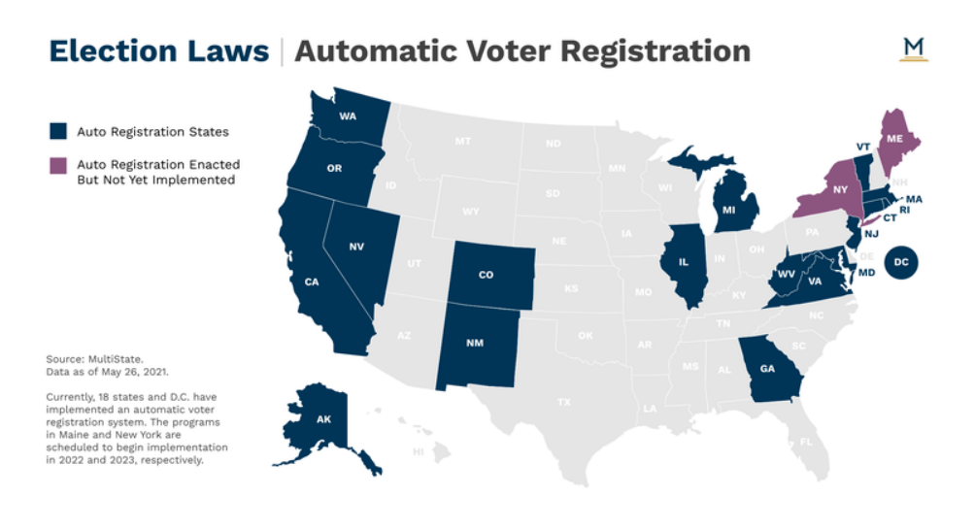
Automatic Voter Registration States

Slide 8
2023 Automatic Voter Registration
New Registrations

Slide 9
Online Voter Registration
Colorado Department of State

Slide 10
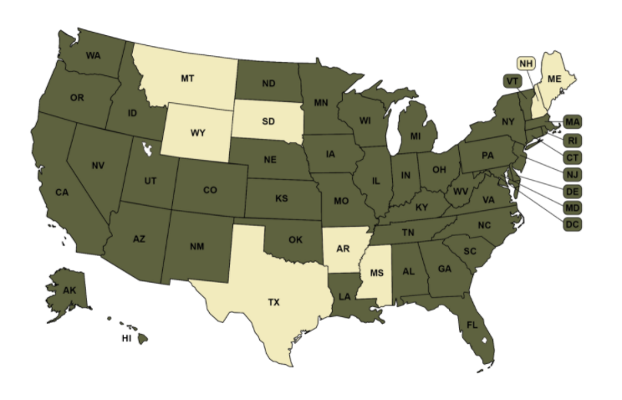
Online Voter Registration
42 states and the District of Columbia have online voter registration. A driver’s license is the basis for every online transaction – except NJ and CO.
The Department of State hosts an online voter registration site at www.govotecolorado.gov. This allows currently registered voters and eligible Coloradans to register to vote online, see a sample ballot, and verify their voter registration.
These applications are typically “complete” upon submission. So, the county approves the entry and sends a 20-day mailing to confirm the address - unless it’s an SSN application without a signature.

Slide 11
2020 New Online Voter Registrations by Month

Slide 12
Current Voter Registration Numbers
Colorado Department of State

Slide 13
Total Number of Registered Voters
2014-2023
Note: As of December 1st each year

Slide 14
Registration By Party
2014-2023

Slide 15
2023 Coordinated Election
Colorado Department of State

Slide 16
2023 Coordinated Election Voter Count

Slide 17
2023 Coordinated Election
Turnout Numbers

Slide 18
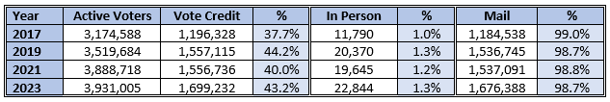
2023 Coordinated Election
Compared to Past Coordinated Elections

Slide 19
2023 Coordinated Election
Turnout Numbers Every County

Slide 20
2023 Coordinated Election Turnout Numbers
11 Most Populated Counties

Slide 21
2023 Coordinated Election Turnout Numbers
21 Least Populated Counties

Slide 22
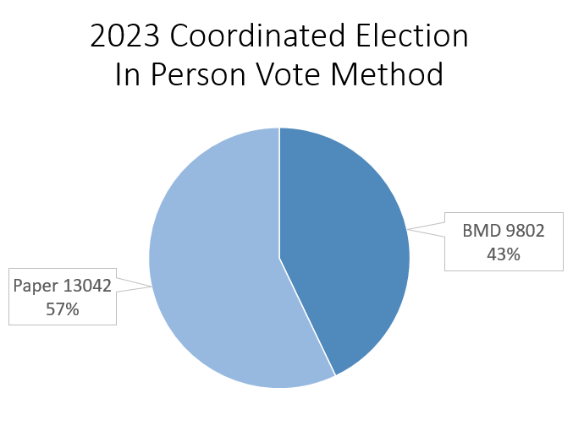
2023 Coordinated Election
Voter Service and Polling Centers
What transactions can occur at a VSPC?:
Vote in person – void mail ballot, issue a new ballot
  Paper ballot
  Ballot Marking Device
Register to vote
Update voter registration
Early Voting October 30-November 6
Election Day November 7
Counties must track wait times
Number of Transactions – 22,844

Slide 23
2023 Coordinated Election
VSPC New Registrations by Day (22,844)

Slide 24
2023 Coordinated Election Turnout
In-Person Voting

Slide 25
2023 Coordinated Election Turnout
Provisional Ballots
33 Provisional Ballots were cast in the 2023 Coordinated Election
  23 accepted
  10 rejected
Party Breakdown:
  13 Unaffiliated (5 rejected)
  12 Democrats (2 rejected)
  8 Republicans (2 rejected)
  1 Libertarian (1 rejected)

Slide 26
2023 Coordinated Election
Canvass Board Data
59* Counties unanimously approved the 2023 Coordinated canvass report.
Five counties did not receive the unanimous sign-off of the canvass report. Those counties were:
  Boulder
  El Paso
  Jefferson
  La Plata
  Larimer
In each case, the Republican representative the canvass board withheld their approval.
*Saguache County changed from a 2-1 vote to a 3-0 vote because the Republican Party Chair did not attend the Canvass. The next day a new Republican representative was appointed, who did approve.

Slide 27
2023 Coordinated Election
Mandatory Recounts
City of Boulder Council vote total changes by candidate:
  Terri Brncic No change
  Jenny Robins +2
  Aaron Gabriel Neyer -1
  Jacques Decalo No change
  Silas Atkins -2
  Waylon Lewis -1
  Ryan Schuchard -1
  Tara Winer No change
  Tina Marquis -1
  Taishya Adams -1

Slide 28
2023 Coordinated Election
TXT2Cure Submissions

Slide 29
2023 Coordinated Election
TXT2Cure for Rejected Ballots
Important Statistics:
3,485 cures submitted via TXT2Cure.
Adams county had the most cures via TXT2Cure, 515 or 14.78% of the total.
The most TXT2Cure submissions happened on Nov. 8th with 528.
The 3,485 TXT2Cure submissions for the 2023 Coordinated is an increase of 1,188 (or 34%) over the 2,297 TXT2Cure submissions in the 2021 Coordinated.

Slide 30
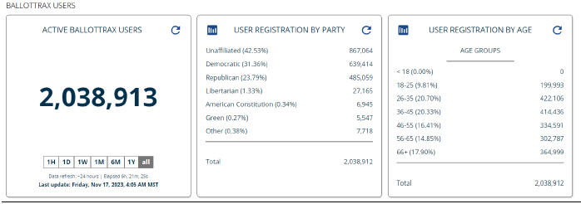
2023 Coordinated Election
BallotTrax Numbers
*50.6% of the state’s registered voters are BallotTrax users.
**By county BallotTrax users vary from a low of 26% in Sedgwick to a high of 67% in Douglas.

Slide 31
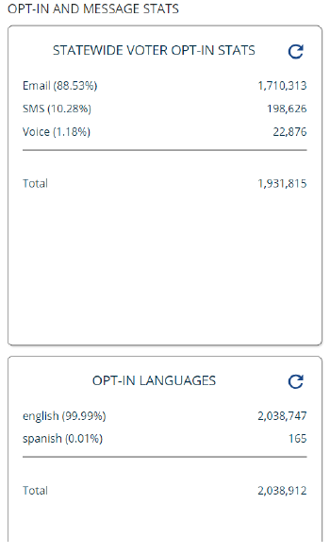
2023 Coordinated Election
BallotTrax Numbers

Slide 32
2023 Coordinated Election
In Person Vote Method

Slide 33
Colorado In Relation to Other States
Colorado Department of State

Slide 34
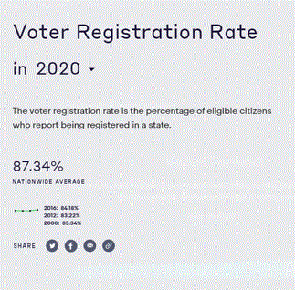
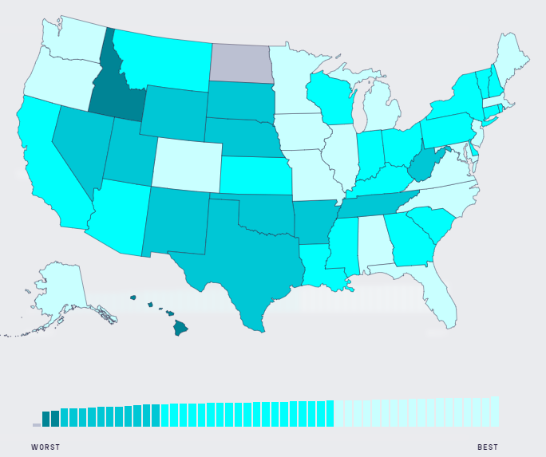
Colorado’s Voter Registration Rate
Compared to the Nation
92.5%

Slide 35
Colorado v. National VEP Turnout
2000-2022

Slide 36
Top States VEP Turnout
2000-2022

Slide 37
Colorado Department of State
Judd Choate, State Election Director
judd.choate@coloradosos.gov
303-869-4927

