Slide 1
Secretary of State’s 2018 Legislative Agenda

Slide 2
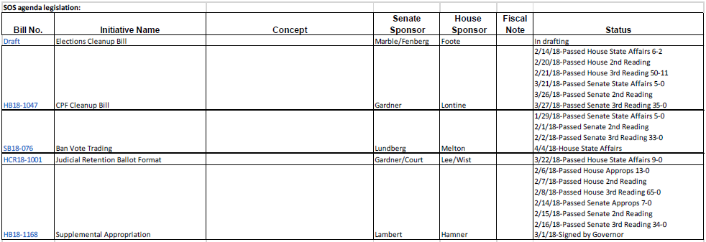
SOS Bills

Slide 3
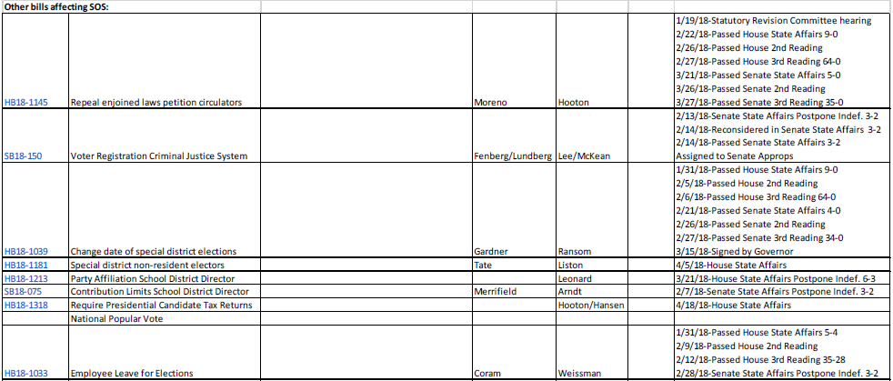
Bills Affecting the SOS

